Slide 1


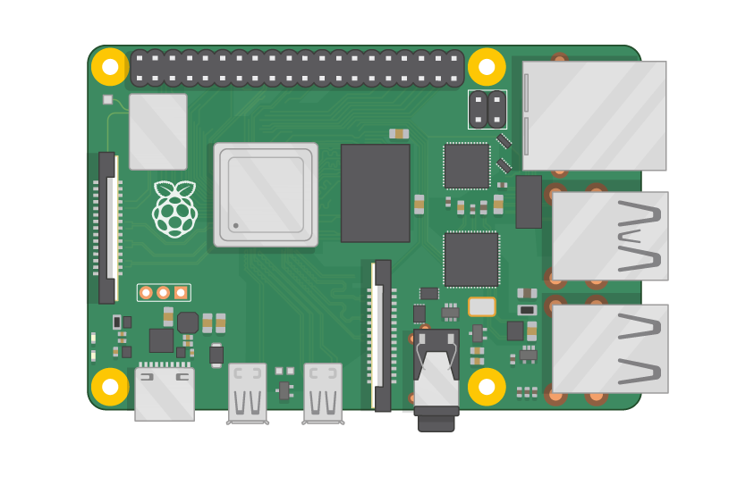
Raspberry Pi Master Class Day-7
Message Transmission using MQTT & UDP Protocol

Slide 2
Table of Contents
01
02
03
04
MQTT Protocol
UDP Protocol
Overview
Overview
Deploying Algorithm
Discussion & Q&A
MQTT & UDP Message Transmission
Interractive session

Slide 3
PREREQUISITES FOR THIS COURSE
Raspberry Pi 3 Model b/B+
16 GB SanDisk class 10 SD Card
Card reader
Laptop with Internet
Power Adapter – 5V 2Amps
USB B-Type Cable

Slide 4
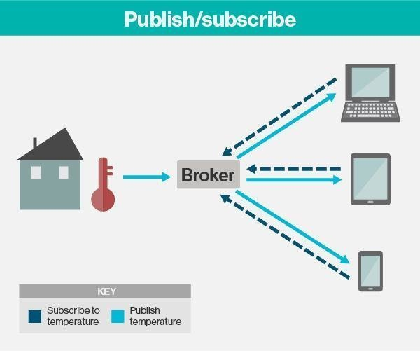
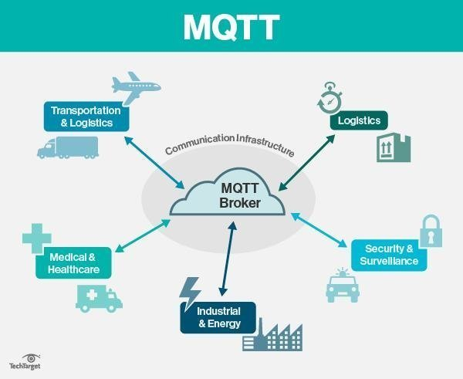
MQTT Protocol…
Message Queing Telemetry Transport is a lightweight messaging protocol that provides resource-constrained network clients with a simple way to distribute telemetry information.
The protocol, which uses a publish/subscribe communication pattern, is used for machine-to-machine (M2M) communication and plays an important role in the internet of things (IoT).
The MQTT protocol surrounds two subjects: a client and a broker. An MQTT broker is a server, while the clients are the connected devices. When a device -- or client -- wants to send data to a server -- or broker-- it is called a publish. When the operation is reversed, it is called a subscribe.

Slide 5
Installing MQTT Library…
sudo pip3 install paho-mqtt

Slide 6
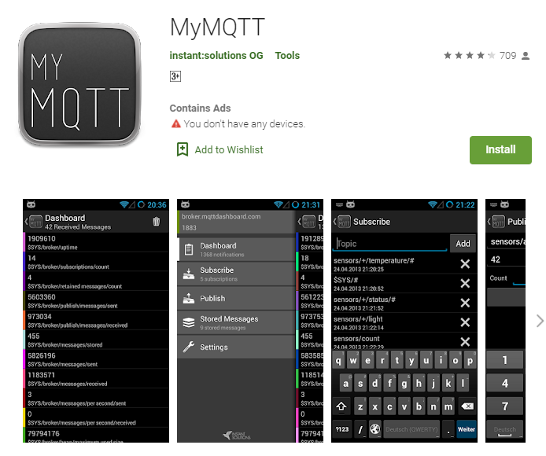
MY MQTT

Slide 7
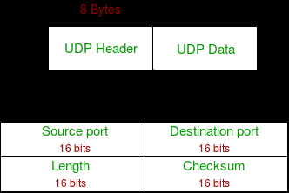
UDP Protocol…
User Datagram Protocol (UDP) is a Transport Layer protocol. UDP is a part of Internet Protocol suite, referred as UDP/IP suite.
Unlike TCP, it is unreliable and connectionless protocol. So, there is no need to establish connection prior to data transfer.
UDP permits packets to be dropped instead of processing delayed packets. There is no error checking in UDP, so it also save bandwidth.

Slide 8
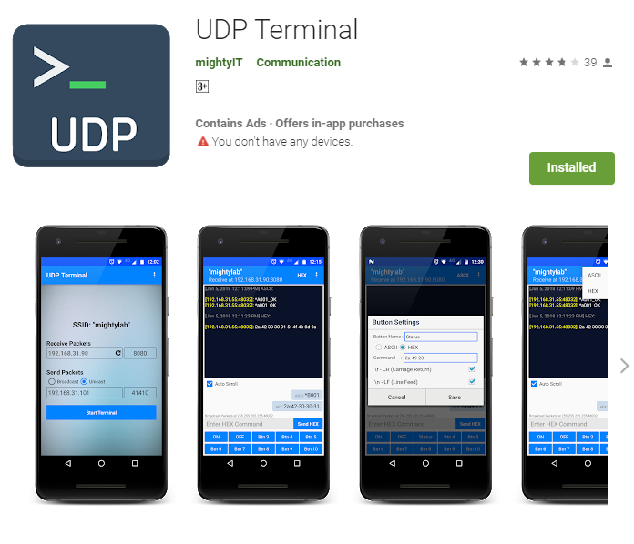
UDP Terminal…

Slide 9
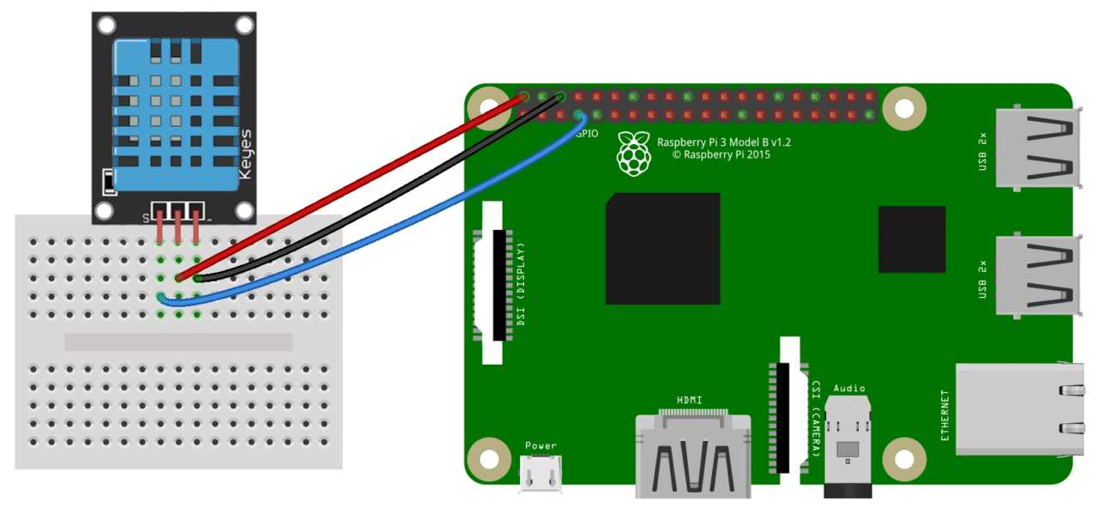
DHT11 with Rpi…

Slide 10
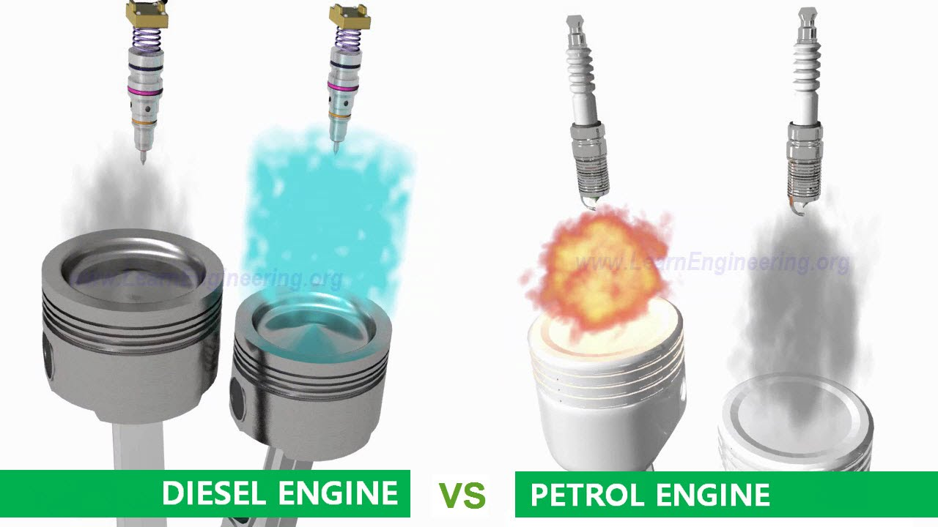
Q7 – Discussion
Both has 4 Strokes, Intake | Compression | Power | Exhaust
Petrol will be easily mixed with Air
Petrol eng. – Fuel & Air is premixed
Diesel eng – Mixing during Combustion
Petrol eng. – Uses spark Plug
Diesel eng, - Uses Fuel injector
Petrol eng. – Less vibration & average Fuel economy
Diesel eng. – More vibration & Good Fuel economy
What if Petrol in Diesel engine & Vice versa?
Petrol Engine vs Disel Engine?

Slide 11

Q8 – Discussion
How mobile works?

Slide 12

New type of atomic clock keeps time even more precisely
Tech News - 7
Dec - 2020
The design, which uses entangled atoms, could help scientists detect dark matter and study gravity's effect on time. A newly-designed atomic clock uses entangled atoms to keep time even more precisely than its state-of-the-art counterparts. The design could help scientists detect dark matter and study gravity's effect on time.

Slide 13
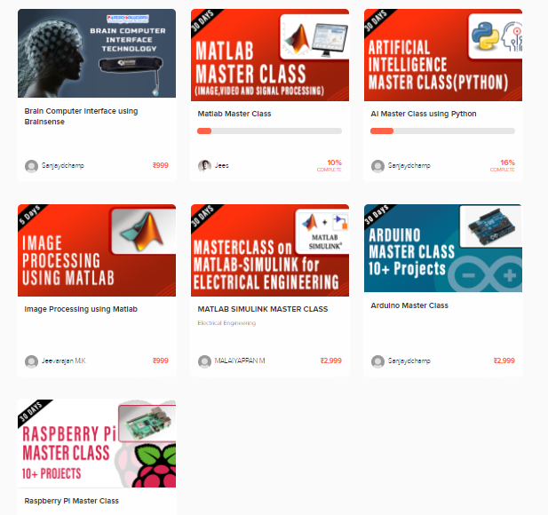
Thanks!
learn.pantechsolutions.net
www.pantechsolutions.net
“I have not failed. I’ve just found 10,000 ways that won’t work”
-Thomas Edison

